Slide 1
Correlates of Opioid and Benzodiazepine Co-Prescription Among People Living with HIV in British Columbia, Canada
Stephanie Parent¹, Seonaid Nolan^{2,3}, Nadia Fairbairn^{2,3}, Monica Ye¹, Anthony Wu¹, Julio Montaner^{1,3}, Rolando Barrios^{1,4}, Lianping Ti^{1,3}, on behalf of the STOP HIV/AIDS in BC Study Group
1. British Columbia Centre for Excellence in HIV/AIDS 2. British Columbia Centre for Substance Use 3. Department of Medicine, University of British Columbia 4. Vancouver Coastal Health
International AIDS Society Conference, Amsterdam, the Netherlands, July 23-27, 2018

Slide 2
Notes:
No recommended by guidelines

Slide 3
Objectives
To estimate the prevalence and correlates of opioid and benzodiazepine co-prescription in people living with HIV in British Columbia (BC)
Methods
STOP HIV/AIDS in BC Cohort: includes all people diagnosed with HIV in BC between January 1996 and March 2015

Slide 4
KEY FINDINGS (n=14 484; 1996-2015)
Multivariable GEE model
Adjusted Odds Ratio
Demographic
Female sex
Age
Calendar Year
Clinical
0.76
1.11
0.65
Mood disorder
Anxiety disorder
Substance use disorder
Charlson comorbidity index
1.32
1.45
0.82
1.09
26% co-prescribed, median of 11 days
Opioid and benzodiazepine co-prescription
Notes:
CD4 and VL were also weakly positively associated with co-prescription.
Results should be interpreted with caution: There is a a paucity of evidence on the impact of co-prescription for PLWH with comorbid needs
Women and PLWH with a substance use disorder may benefit from better evidence-based care or be under-prescribed
Future research should explore co-prescription practices to determine their appropriateness in these circumstances.
Efforts to monitor prescribing practices warranted to determine their appropriateness in these circumstances.
,

Slide 5
Questions?

Slide 6
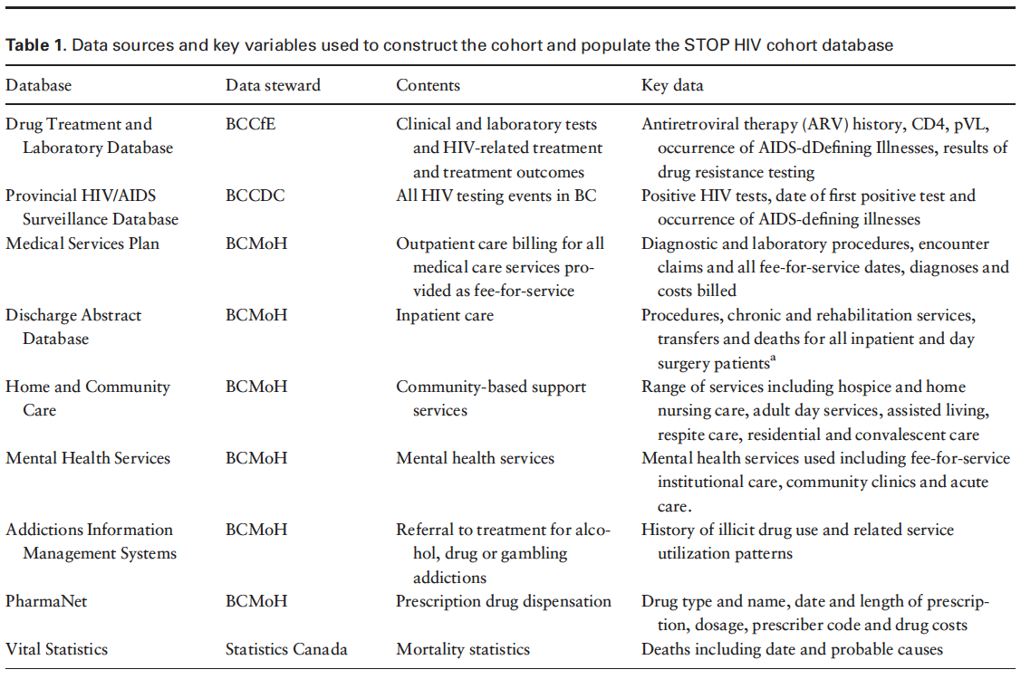
Methods: STOP HIV/AIDS Cohort

